Slide 1

Microsoft Word in Business (II)
LECTURE 5

Slide 2
Mail Merge
Mail merge has become a very common tool. It allows copies of a document to be created with each copy customized in certain way.
This can be very useful for documents like
  Emails
  Letters
  Envelopes
  Mailing labels

Slide 3
Activity 1
Step 1:
  Type the following document (on the next slide) exactly as it appears
  Note: don’t type <blank line>, <<Address block>> and <<Greeting line>>, just leave space by pressing Enter

Slide 4
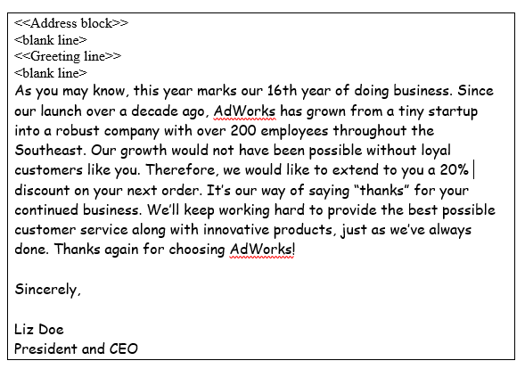

Slide 5
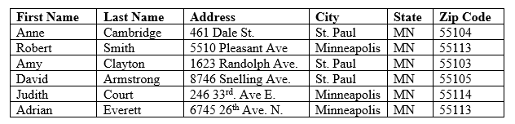
Step 2:
  Enter the addresses (to whom you want to send the letters)
Step 3:
  Merge the letter and the addresses.
Step 4:
  Create a document or print all the letters

Slide 6
Activity 2 - Homework
Prepare a Newsletter (one page) using Microsoft Office Word.
Note: You should not use any templates.
Submit the Newsletter in Tutorial-5 to get the feedback.

